Slide 1

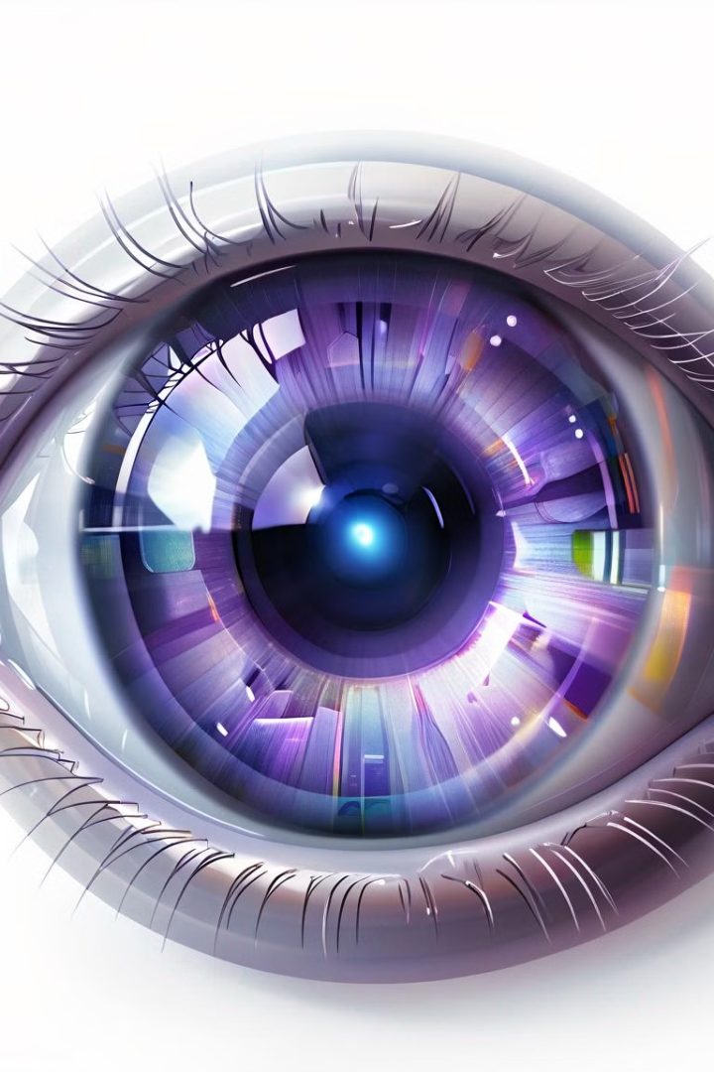
Introduction to Ocular Eye Diseases
Explore the complex world of ocular eye diseases, where cutting-edge deep learning techniques are revolutionizing early detection and treatment. Gain insights into the latest advancements in this critical field of ophthalmology.
By Devansh Beri
219301113

Slide 2

Convolutional Neural Networks for Image Analysis
Convolutional Neural Networks (CNNs) are a powerful deep learning technique that excel at analyzing and classifying visual data. CNNs leverage the spatial structure of images to learn relevant features and patterns, making them highly effective for medical image analysis tasks such as disease detection and diagnosis.
The hierarchical architecture of CNNs, with alternating convolutional and pooling layers, allows the model to progressively extract more complex features from the input image. This enables robust feature extraction and classification, even for subtle or complex ocular conditions.

Slide 3
Overview of Deep Learning Algorithms
Convolutional Neural Networks (CNNs)
Recurrent Neural Networks (RNNs)
CNNs excel at image recognition tasks by automatically learning features from data. They are commonly used in medical imaging, such as for detecting eye diseases.
RNNs process sequential data like text and speech, making them useful for applications like disease diagnosis from clinical notes.
Generative Adversarial Networks (GANs)
Transformer Models
Transformer models like BERT have shown promising results in natural language processing tasks relevant to clinical decision support systems.
GANs can generate synthetic medical images, which can be used to augment limited training datasets for deep learning

Slide 4
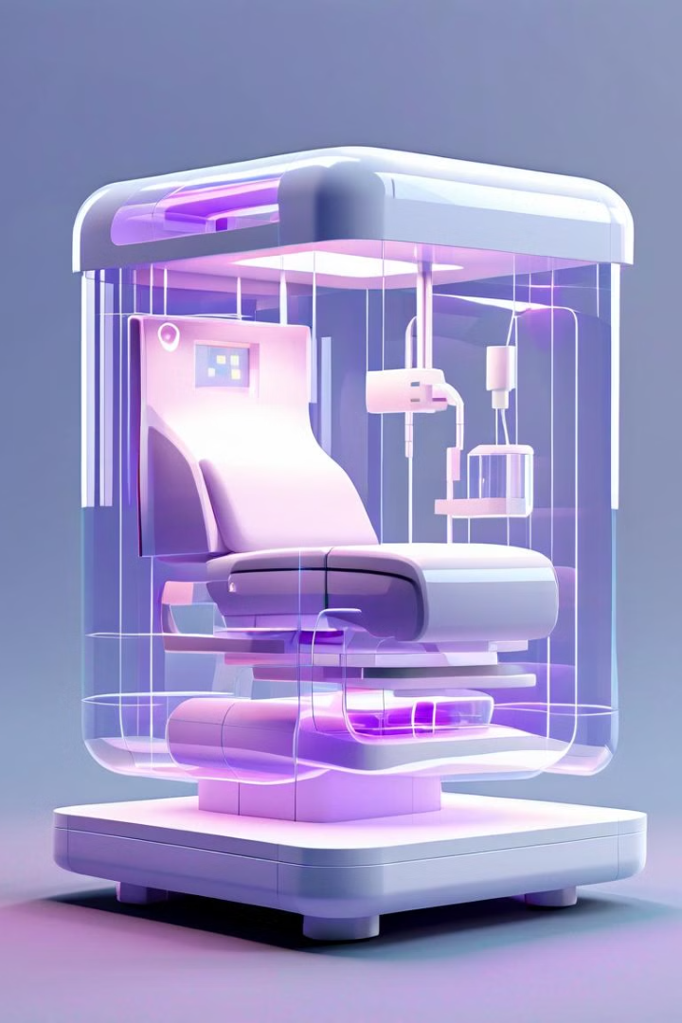
VGG-16 for Ocular Disease Classification
The VGG-16 convolutional neural network, originally developed for general image classification, has shown promising results in the detection and diagnosis of various ocular diseases. This deep learning model can effectively extract complex visual features from retinal and eye images, enabling accurate classification of conditions like diabetic retinopathy, macular degeneration, and glaucoma.
By fine-tuning the pre-trained VGG-16 model on large, curated datasets of ocular images, researchers have achieved state-of-the-art performance in identifying and differentiating between multiple eye diseases, paving the way for improved clinical decision-making and early intervention.

Slide 5

ResNet-50 for Ocular Disease Diagnosis
ResNet-50 is a powerful deep learning model that has shown promising results in the detection and diagnosis of various ocular diseases. Its residual learning framework allows for the training of very deep neural networks, which is crucial for accurately identifying complex eye pathologies.
By leveraging the inherent feature extraction and hierarchical representation capabilities of ResNet-50, clinicians can gain valuable insights into the underlying causes of ocular conditions, leading to more accurate and timely interventions.

Slide 6
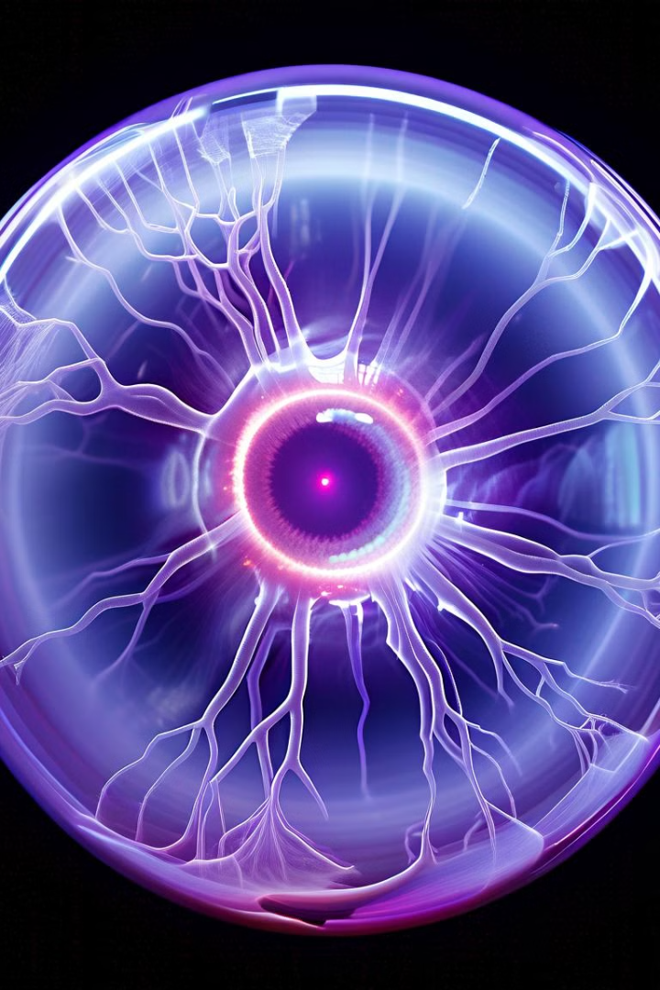
Inception-V3 for Retinal Image Analysis
Inception-V3, a powerful deep learning model, has shown impressive results in the analysis of retinal images for the detection and diagnosis of various ocular diseases. This architecture is adept at capturing complex visual patterns in the intricate structures of the retina, including the blood vessels, optic disc, and macula.
By leveraging the model's ability to learn hierarchical visual representations, ophthalmologists can gain valuable insights into the health of the eye, enabling earlier diagnosis and more personalized treatment approaches.

Slide 7
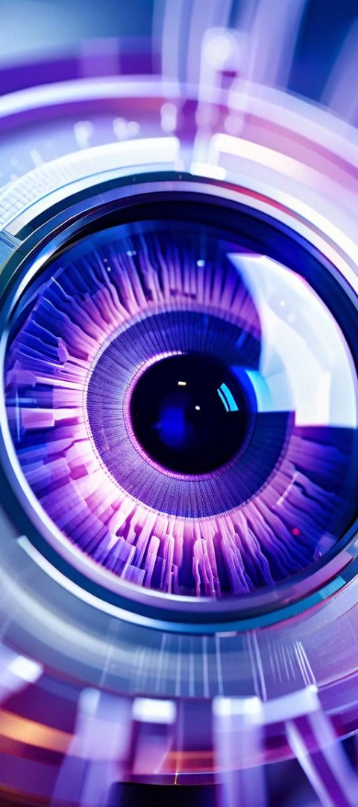
Dataset Preparation for Ocular Disease Detection
1
Data Collection
Gather a comprehensive dataset of ocular images, including various eye conditions and healthy samples. Ensure diversity in terms of age, ethnicity, and disease severity.
2
Image Preprocessing
Preprocess the images by applying techniques such as resizing, normalization, and augmentation to increase the dataset size and improve model generalization.
3
Label Annotation
Carefully annotate each image with the corresponding ocular disease label or healthy classification. This step is crucial for supervised learning models.

Slide 8

Preprocessing and Data Augmentation
1
Data Preprocessing
Standardize image sizes, normalize pixel values, and handle missing or corrupted data to ensure consistency and quality of the training dataset.
2
Image Augmentation
Apply techniques like rotation, flipping, scaling, and color jittering to artificially expand the training dataset and improve model generalization.
3
Oversampling and Undersampling
Address class imbalance by oversampling minority classes or undersampling majority classes to create a more balanced dataset.

Slide 9

Model Architecture and Training
Key elements of the model architecture include convolutional layers for feature extraction, pooling layers for dimensionality reduction, and fully connected layers for classification. The model is trained using labeled ocular disease data, optimizing parameters to minimize a loss function and maximize performance metrics.
Data augmentation methods, such as flipping, cropping, and color jittering, play a crucial role in enhancing the performance of machine learning models by increasing their ability to generalize and handle variations in input data. By applying these techniques to the training dataset, the model is exposed to a broader range of scenarios, effectively expanding its understanding of the underlying patterns.

Slide 10
Training and Validation of Deep Learning Models
Preparing the Dataset
Splitting the Data
Transfer Learning
Model Training
Train the deep learning models using the training dataset, optimizing hyperparameters such as learning rate, batch size, and regularization techniques to achieve the best performance on the validation set.
Curate a comprehensive dataset of ocular disease images, ensuring balanced representation across different conditions. Preprocess the images by standardizing size, enhancing contrast, and normalizing pixel values to optimize model performance.
Divide the dataset into training, validation, and test sets to evaluate model performance objectively. Maintain a representative distribution of disease cases in each subset to avoid biased evaluation.
Leverage pre-trained deep learning models, such as VGG-16, ResNet-50, or Inception-V3, as a starting point. Fine-tune the model parameters using the ocular disease dataset to adapt the model to the specific task.

Slide 11
Performance Evaluation of Deep Learning Algorithms
To evaluate the performance of deep learning algorithms for ocular disease detection, key metrics such as accuracy, precision, recall, and F1-score will be analyzed. A comparison table will be presented to showcase the strengths and weaknesses of different models, including VGG-16, ResNet-50, and Inception-V3.
Model
Accuracy
Precision
Recall
F1-Score
VGG-16
94.8%
0.354
0.354
0.354
ResNet-50
98.4%
0.225
0.225
0.225
Inception-V3
66.7%
0.244
0.243
0.241

Slide 12
Evaluation Metrics and Performance
1
Accuracy Metrics
2
Sensitivity and Specificity
Assess the model's ability to correctly classify ocular diseases using metrics like overall accuracy, precision, recall, and F1-score.
Measure the model's sensitivity in detecting disease cases and its specificity in avoiding false positives.
3
Area Under the Curve (AUC)
4
Inference Time
Evaluate the model's overall discriminative power using the AUC of the Receiver Operating Characteristic (ROC) curve.
Analyze the model's inference speed and latency to ensure real-time performance in clinical settings.

Slide 13
Clinical Applications of Deep Learning in Ophthalmology
1
Automated Retinal Disease Diagnosis
2
Ophthalmic Image Segmentation
Deep learning models can analyze retinal images to detect and classify conditions like diabetic retinopathy, age-related macular degeneration, and glaucoma with high accuracy, enabling early intervention and improved patient outcomes.
Advanced deep learning algorithms can precisely segment key anatomical structures in the eye, such as the optic nerve and blood vessels, supporting more accurate diagnoses and treatment planning.
3
Personalized Treatment Recommendations
4
Real-Time Monitoring and Alerts
By integrating patient data and medical history, deep learning models can provide tailored treatment recommendations, optimizing therapy for individual patient needs and improving overall care quality.
Deep learning-powered systems can continuously monitor patient eye health, triggering timely alerts for eye care professionals to intervene before vision-threatening conditions worsen.

Slide 14
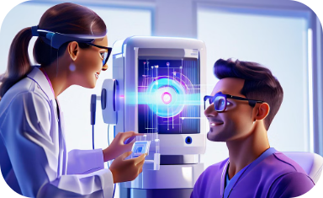
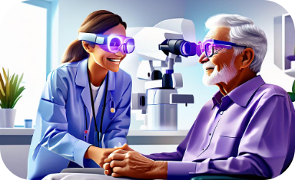

Case Studies and Success Stories
Diagnosing Diabetic Retinopathy
Improving Age-Related Macular Degeneration Screening
Advancing Glaucoma Diagnosis
A team of ophthalmologists used deep learning algorithms to analyze retinal images, leading to early detection of diabetic retinopathy and timely treatment for patients, drastically improving outcomes.
A multidisciplinary team leveraged deep learning to automate the analysis of optic nerve scans, significantly reducing the time and expertise required to diagnose glaucoma, a leading cause of irreversible blindness.
Researchers developed a deep learning model that could identify early signs of age-related macular degeneration from eye scans, allowing for prompt intervention and slowing disease progression in many patients.

Slide 15
Challenges and Limitations
Data Scarcity
Interpretability
Generalization
Hardware Requirements
Obtaining large, high-quality datasets of ocular diseases can be challenging, limiting the ability of deep learning models to learn robust representations.
Deep learning models can be complex and opaque, making it difficult to understand the reasoning behind their predictions, which is crucial for medical applications.
Deep learning models may struggle to generalize well to new, unseen data, particularly when dealing with the diverse manifestations of ocular diseases.
Training and deploying deep learning models for ocular disease diagnosis can require significant computational resources, which may limit their accessibility in resource-constrained settings.

Slide 16

Ethical Considerations
To ensure patient privacy and data security, robust mechanisms must be implemented. This involves employing encryption, access controls, and compliance with regulations like HIPAA or GDPR. Regular audits and staff training are also essential. These measures safeguard sensitive medical data and maintain patient confidentiality, building trust in healthcare systems.
To address potential algorithmic bias, it's crucial to meticulously assess deep learning models for any biases that could result in unfair or discriminatory outcomes. This involves thorough evaluation and mitigation strategies to ensure fairness and equity in decision-making processes. By actively identifying and addressing biases, we can promote inclusivity and fairness, fostering trust in AI systems and promoting social justice.
Promoting transparency and explainability in deep learning models involves efforts to make their decision-making processes more interpretable and understandable for healthcare professionals and patients. This includes implementing techniques such as model documentation, providing insights into feature importance, and utilizing interpretable model architectures. By enhancing transparency, we empower stakeholders to better comprehend and trust the decisions made by AI systems, ultimately improving collaboration, patient care, and overall acceptance of AI in healthcare.

Slide 17
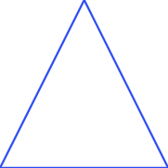


Conclusion and Future Directions
Continued Research
1
Advancing deep learning techniques for early detection and diagnosis of ocular diseases
Clinical Integration
2
Seamless integration of AI-powered solutions into medical workflows
Ethical Considerations
3
Addressing privacy, bias, and transparency in the deployment of these technologies
In conclusion, the application of deep learning in the field of ocular disease detection and diagnosis holds immense promise. As we move forward, continued research to refine and optimize these techniques, coupled with thoughtful integration into clinical practice and a strong emphasis on ethical considerations, will be key to unlocking the full potential of this transformative technology. The future is bright, with the opportunity to significantly improve patient outcomes and revolutionize the way we approach eye health.

